Slide 1

CLOUD COMPUTING CAPSTONE
Event Registration
& Ticketing System
A serverless REST API on AWS
Osikanyi Essandoh
OsiaknyiTheDev

Slide 2




The Problem
No input validation
Event registration today is
Microsoft Forms + Excel.
Garbage data sneaks in unnoticed
No confirmations
Attendees are never sure they registered
GOAL
No monitoring
Replace it with a real, scalable, monitored API.
Problems stay invisible until someone complains
Doesn't scale
No API for websites or other tools to plug into

Slide 3





The Solution: Serverless API
4 REST Endpoints
Real-Time Validation
Automatic Confirmations
Full registration lifecycle, one route per action
Duplicate prevention built into every write
SNS sends an email the moment you register
Live Monitoring
Infrastructure as Code
Idle Cost ≈ $0
CloudWatch dashboards and alarms, always on
Reproducible Terraform, fully version-controlled
Fully serverless, on-demand billing only

Slide 4
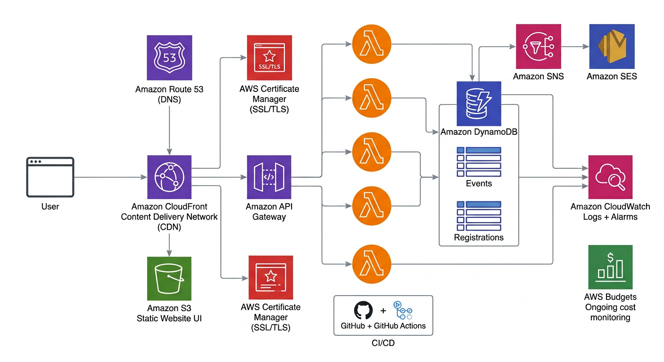
Architecture
Client → CloudFront/API Gateway → Lambda → DynamoDB — fully serverless, event-driven

Slide 5
The API — 4 Endpoints
GET
/events
200
List all events
/register
201
POST
Register for an event
200
GET
/registrations/{email}
View a person's sign-ups
/registration/{id}
200
DELETE
Cancel a registration
/admin/events
201
POST
Add a new event
/admin/events/{id}
200
DELETE
delete an registration
Errors map to real HTTP codes
400 bad input · 404 not found · 409 already registered · 500 internal

Slide 6






Engineering Highlights
Modular Terraform
Least-Privilege IAM
7 reusable modules — dynamodb, iam, lambda, api_gateway, sns, alarms, budgets
Scoped to exact table ARNs, never "*"
DynamoDB GSI on Email
35 Unit Tests with Moto
Instant lookups — no full-table scans
AWS mocked, runs in ~2s, no account needed
Idempotent Operations
CI/CD with Branch Protection
Safe to retry, no duplicate rows ever written
No merge without green checks

Slide 7
Live Demo
The API
$ API=”https://e7pkqb4we8.execute-api.us-east-1.amazonaws.com/dev”
$ curl $API/events | python3 -m json.tool
→ 200 . JSON list of events (JSON)
$ curl -X POST "$API/register" -H "Content-Type: application/json" -d '{"event_id":"aws-bootcamp","email":"osikanyie@gmail.com","name":"Osikanyi"}' | python3 -m json.tool
→ 201 . Created + confirmation email in the inbox
$ curl $API/registrations/osikanyie@gmail.com | python3 -m json.tool
→ 200 . your registrations
$ curl -X DELETE $API/registration/{id} | python3 -m json.tool
→ 200 . cancelled
The UI (for the live demo):
→ https://ticketservice.osikanyi.online

Slide 8

Tech Stack
Language
Notifications + Monitoring
Python 3.12
SNS, CloudWatch Logs & Alarms
Infra-as-Code
Cost Control
Terraform — modules + remote S3 state
AWS Budgets (Free-Tier guard)
Compute
CI/CD + Testing
AWS Lambda
GitHub Actions, pytest, moto, ruff
API + Database
API Gateway (REST) + DynamoDB (on-demand, GSI)

Slide 9

What I Learned
Infrastructure-as-Code discipline — plan, validate, apply
Serverless trade-offs: scaling & cost vs. cold starts
Testing AWS code locally with moto, no cloud needed
Git workflow maturity: branches, PRs, CI gates, tags
Cost awareness and Free-Tier engineering
Reading errors and docs to debug real cloud problems

Slide 10

Thank You
Event Registration & Ticketing System — A Serverless REST API on AWS
github.com/OsikanyiTheDev/event-ticketing-system
Osikanyi Essandoh

